Slide 1

ISDS 552 GP4
TEAM MEMBERS:
DEEPAM KHIRWAR
HARSHITA DIDWANIA
KAVINDU WALIMUNIGE
SANCHIT SINGH
SATHIYA PRIYA JEEVANANDAN

Slide 2
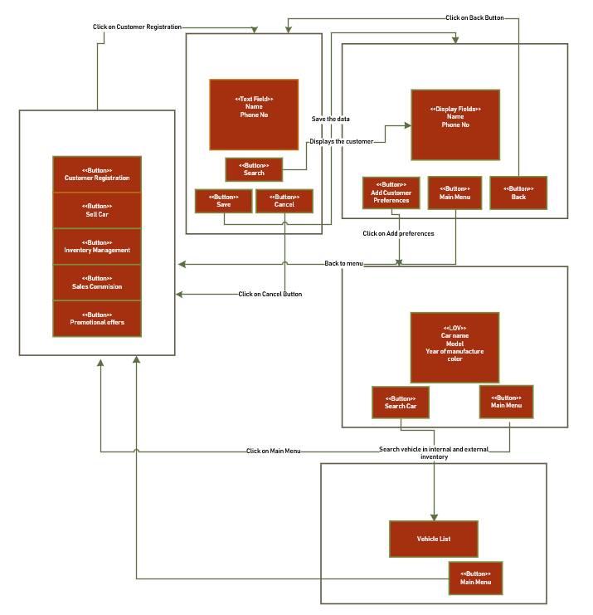
WND- match customer with vehicles

Slide 3
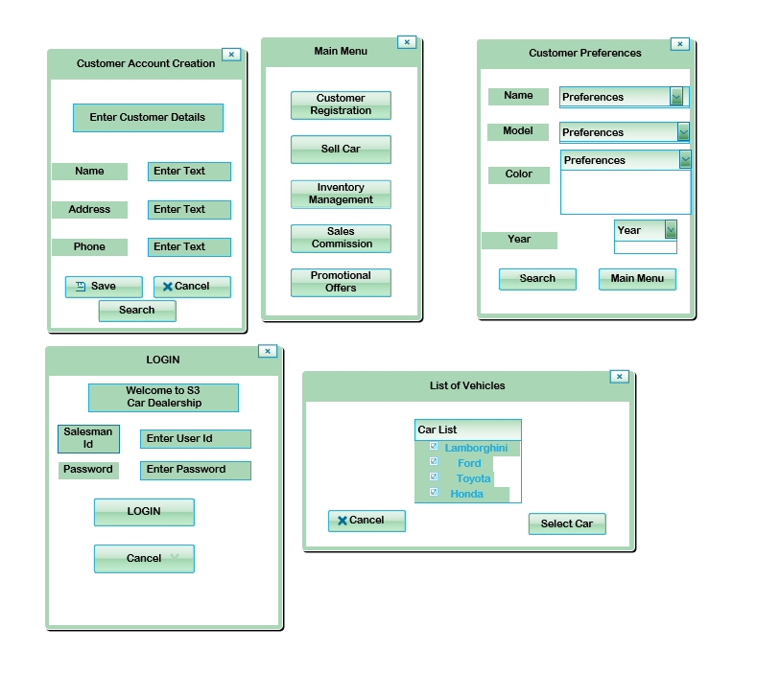
GUI- Match Customer with Vehicles

Slide 4
End of presentation
Thank you!

